Slide 1


Professional Placements at Kingston University webinar:
Making Connections

Slide 2


Assignment 3: Webinar: ‘Making connections’
Induction update
How to create your Linked in profile
Business etiquette
E-hireability and your brand
Business language support
Resilience
Assignment: Attendance of LinkedIn workshop
Upload evidence of your LinkedIn profile and connections made

Slide 3



Induction update
To give quick update on the following:-
Key information we covered in induction
Access to Jobs Central & My Careers & Employability
CV workshops / drop in sessions

Slide 4
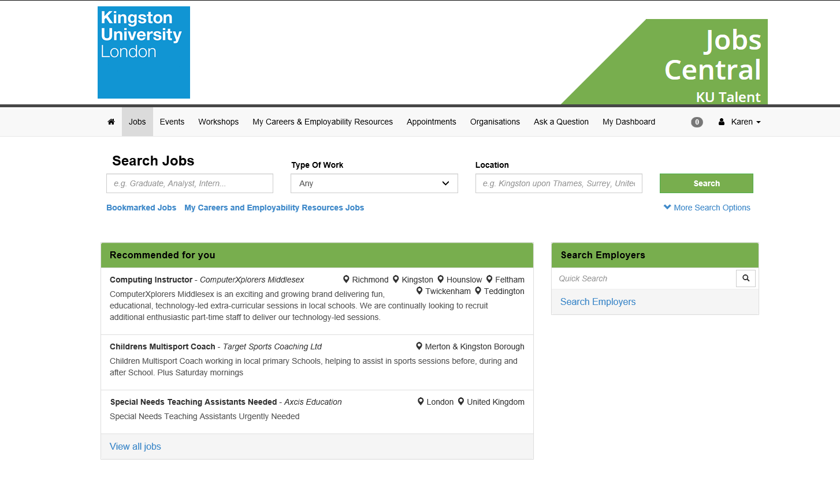
Jobs Central
Online KU job portal.
Notes:
Have you all familiarised yourself with My Careers & Employability portal? You access this through jobs central and
Highlight any specific areas? -CV and applications?
Should we demonstrate jobs central – in particular the jobs search function?

Slide 5
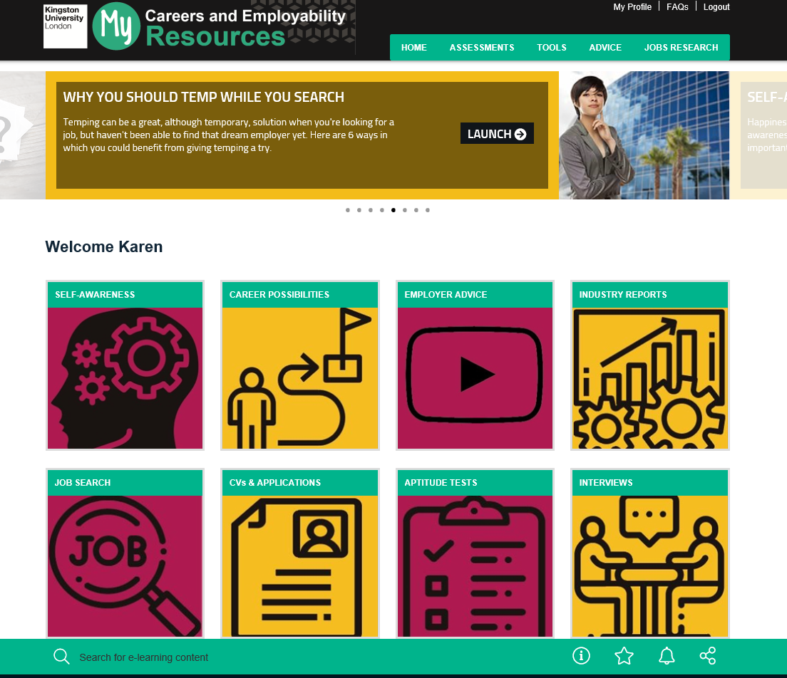
My Careers and Employability website
There is a wealth of online tools available here.
Notes:
Have you all familiarised yourself with My Careers & Employability portal? You access this through jobs central and
Highlight any specific areas? -CV and applications?
Should we demonstrate jobs central – in particular the jobs search function?

Slide 6
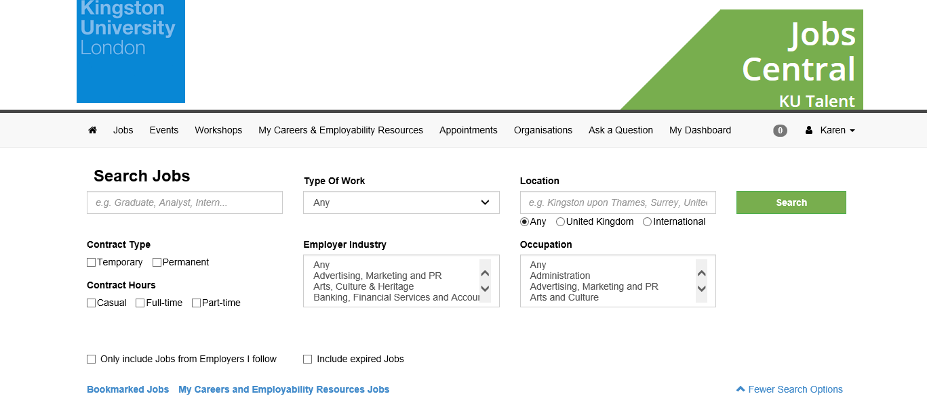
Workshops
Dates and booking available on https://jobscentral.kingston.ac.uk/ Follow the workshop tab…

Slide 7
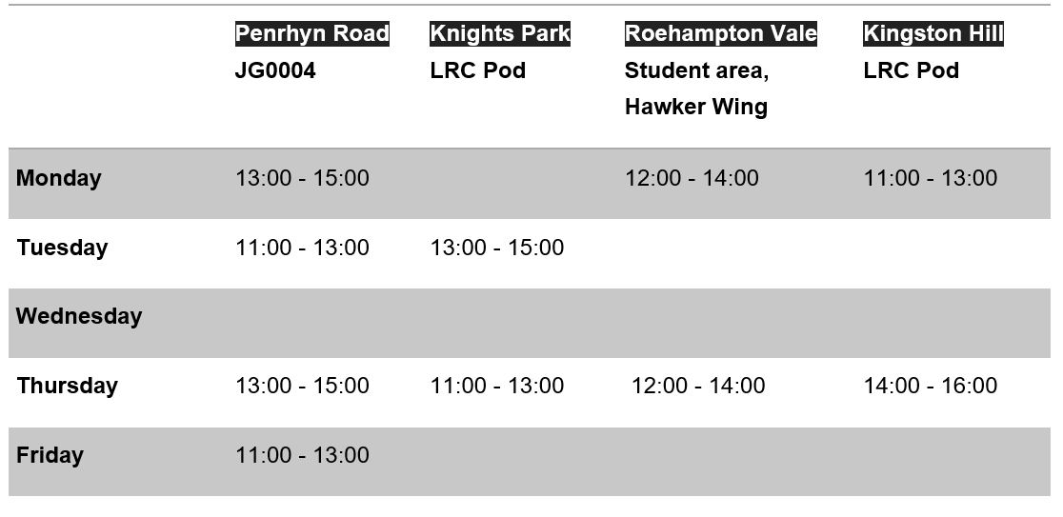
CV drop in sessions

Slide 8



How to create your LinkedIn profile
94% of recruiters used social media in their recruitment efforts so it’s important to be present online.
Your picture
Your headline
About
Your experience
Recommendations
Interests
Focus on filling out what you have.
Notes:
.

Slide 9


Assignment
Attend: “Using LinkedIn to Find a Job workshop”
When: recorded session: https://bit.ly/2BlJ14k
Assignment: Upload LinkedIn profile by 1 November
By attending this workshop we'll show you how to use the functionality of LinkedIn to help you find and apply to both advertised and hidden jobs, and show you how to build your brand online.
By the end of the session you will be able to:
Identify the value of using LinkedIn in your job search versus other social media sites
Explain the different aspects of the Job Search tool and how it can be used in your job search
Describe the range of ways that using LinkedIn can support you in a speculative approach to employers
Construct your LinkedIn profile to increase visibility to employers and recruiters
Demonstrate competence in your field of expertise through the use of LinkedIn

Slide 10


Approaching companies
Basic introduction emails:
Make sure that any communication is polite and formal
Don’t use text language
Make sure there are no spelling mistakes
Reply to all emails
Find the name of the person responsible for recruitment.
If you are attaching your CV to an email, explain that clearly in your email “please find attached….”
Make sure your emails are called something appropriate too e.g. Your Name: Potential Job Opportunity?

Slide 11
Approaching companies
Face to face networking:
Most of us have formed an opinion of each other before meeting face to face.
Don’t stand up people for meetings, or be late
Carry copies of your CV with you.
Research some of the companies in advance and have some questions prepared.
Put your mobile phone on silent and check at appropriate break times.
Prepare what you want to say – practice if necessary at home with friends.
Have a statement about ‘you’ prepared. This is sometime known as your elevator pitch.

Slide 12
Business etiquette
Applying for jobs:
Study the job description and work out the key words/skills they are looking for.
Make sure you use these key words and give 2-3 different examples per skill.
Some jobs may require you to do psychometric tests
General UK jobsites:-
www.gradcracker.co.uk
www.stemgraduates.co.uk
www.totaljobs.co.uk
www.jobexperts.co.uk
www.reed.co.uk
www.indeed.co.uk
www.ratemyplacement.co.uk
www.targetjobs.co.uk
www.monster.co.uk
5. Join Professional bodies
6. Company websites

Slide 13
Professional bodies
Some suggested organisations to contact (there will be others):
Pharmacy: http://careers.abpi.org.uk/getting-into-the-industry/pharmaceutical-recruiters/Pages/default.aspx (ABPI)
Mechanical and Automotive Engineering:
www.imeche.org/
www.theimi.org.uk/
Aerospace Engineering: https://www.aerosociety.com/careers-education/
Computer Science: http://www.bcs.org (Chartered Institute for IT)
Construction management: www.ciob.org/
Building Surveying: https://www.rics.org/uk/

Slide 14


E-hireability
Your online footprint is all the information you can find about yourself online.
If you haven’t searched Google for your own name already, you should.
You are going to need to write about things that you want people to associate with you.
For new career opportunities take a look at employees at companies you’d like to work for and how they present themselves.
Sharing content and commenting on group posts is an easy way to keep your brand visible and relevant
Make sure your theme is consistent throughout the various platforms that you use.
E-portfolio – an electronic portfolio showing your what you can do and what you offer visually . If your industry uses these – make sure you have one.

Slide 15


Business language support
Business language resources are available on Canvas under ‘Key information’ on the home page
There are open courses available for you on Employability Communication Skills (writing, speaking skills and language for the work place e.g. interviews, CV, cover letters and more).
Go to https://kuplus.Kingston.ac.auk/ and enter EAPD and select Employability Communication Skills to enrol
These take place:
Weeks | DAY | TIME | ROOM
Weeks 2-10 17 Jan – 13 March | Friday | 2-4 pm | PRJG3014

Slide 16


Resilience
Tips to build resilience:-
Look after yourself
Seek advice/help from CL, careers team, placement co-ordinators.
Learn from each knock back.
Student Wellbeing can offer support if you are having difficulties or issues. They offer NHS services along with counselling sessions and self help guides.
Further information can be found on studenthub.Kingston.ac.uk / 020 8417 2172

Slide 17
Assignment
Attend: Using LinkedIn to Find a Job workshop
When: Recorded session: https://bit.ly/2BlJ14k
Assignment: Upload evidence of LinkedIn profile made by 1 November

Slide 18


Contacts
Your individual Course Leader can provide specific information and support about your chosen career path.
The Careers and Employability team offer a wide range of workshops/events and drop in sessions. careers@kingston.ac.uk T: 0208 417 7745
Come and see us. We are based in the SEC Student Office. SECPGplacements@Kingston.ac.uk T: 0208 417 2453 or 0208 417 4319

